Slide 1
Practical Application of Algorithms
Maze Problem
Prepared By:
Akshay Patel
Guided By:
Pro. Dr. Chang, Henry

Slide 2
What is the ‘Maze’?
﻿﻿But what if we solve it using computer.????
Maze means the confusing in the nature.
A network of paths and hedges designed as a puzzle through which one has to find a way.
It is easy to understand for a matured person.

Slide 3
Abstraction
Navigating through a maze is a classic problem that arises in various fields, including robotics, game development, and pathfinding algorithms.
At its core, the task involves finding a route from a starting point to a destination within a complex network of interconnected pathways, where some paths may lead to dead ends or loops.
This problem has real-world applications in robotics, where robots need to autonomously navigate through environments to perform tasks efficiently and safely.
Pathfinding algorithms, a key component of maze navigation, are also used in logistics, network routing, and even in optimizing traffic flow.

Slide 4
Available Approaches
Various strategies can be employed to solve maze navigation problems, including depth-first search, breadth-first search, Dijkstra's algorithm and others.
Each approach has its strengths and weaknesses, making them suitable for different types of mazes and constraints.

Slide 5
Backtracking and Breadth-First Traversal (BFS)?
We will solve this problem using backtracking.
﻿﻿The reason behind this is we have predefined constraints.
﻿﻿Hence it facilitates some ease for the programmer to choose the best solutions. It also avoids undesired computations.
In BFS, the exploration starts at a given vertex (or cell in the case of a maze) and systematically explores all the neighboring vertices (cells) at the present depth level before moving on to vertices at the next depth level.
This strategy ensures that the algorithm explores all possible paths starting from the initial cell before moving deeper into the maze.

Slide 6
Use Cases and Applications
Robotics: Autonomous robots often need to navigate through complex environments, and BFS can help them find the shortest path to their destination while avoiding obstacles.
Game Development: Many video games feature maze-like environments where characters need to find their way through. BFS can be used to implement pathfinding for NPCs (non-player characters) or to generate levels.
Network Routing: BFS can be used to find the shortest path between nodes in computer networks, aiding in efficient data transmission.
Puzzle Solving: Mazes are often used as puzzles, and BFS can help solve them efficiently.

Slide 7
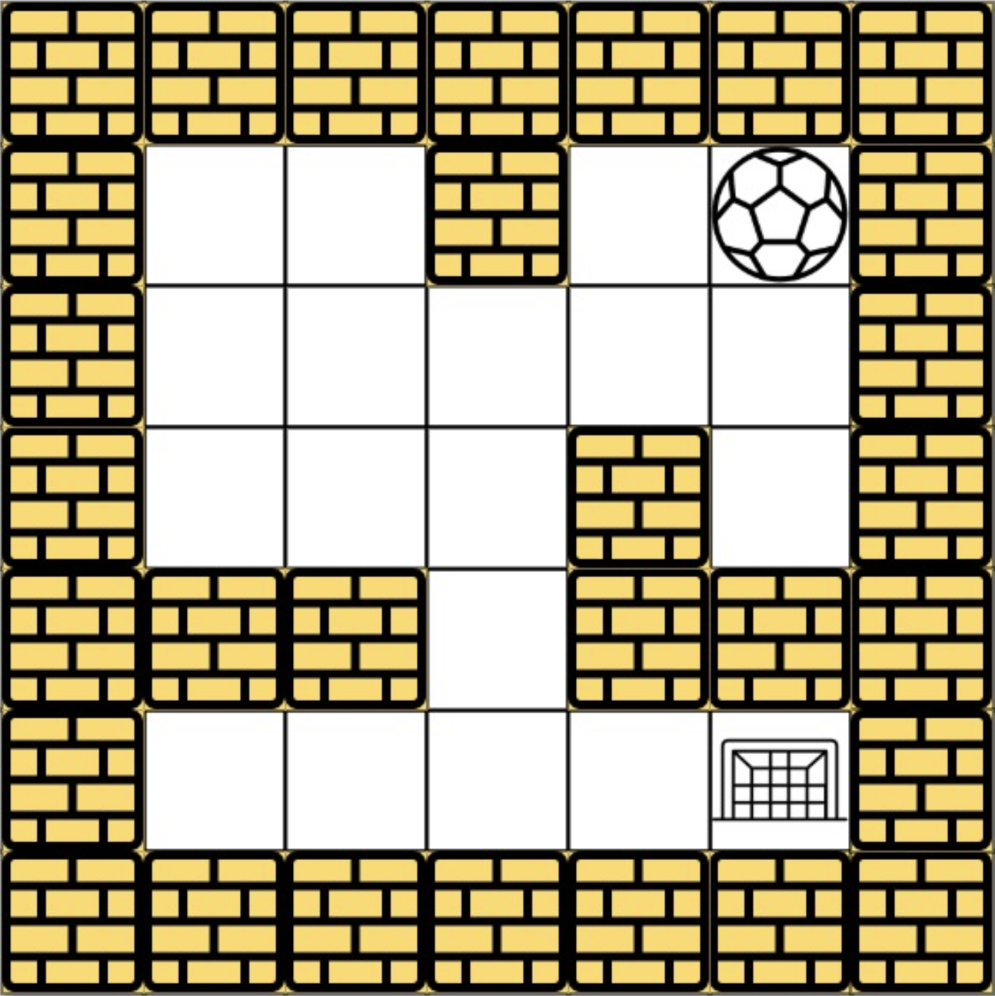
Example:
There is a ball in a maze with empty spaces (represented as 0) and walls (represented as 1). The ball can go through the empty spaces by rolling up, down, left or right, but it won't stop rolling until hitting a wall. When the ball stops, it could choose the next direction.
We have make a goal by sending ball in to the net.

Slide 8
Given the m x n maze, the ball's start position and the destination, where start = [start row, start col] and destination = [destination row, destination col], return true if the ball can stop at the destination, otherwise return false
maze = [[0,0,1,0,0],
[0,0,0,0,0],
[0,0,0,1,0],
[1,1,0,1,1],
[0,0,0,0,0]]
start = [0,4],
destination = [4,4]

Slide 9
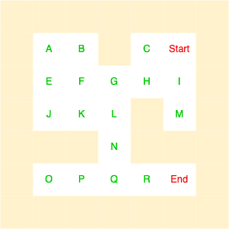
Change gives alphabetic number to the each box in the maze

Slide 10
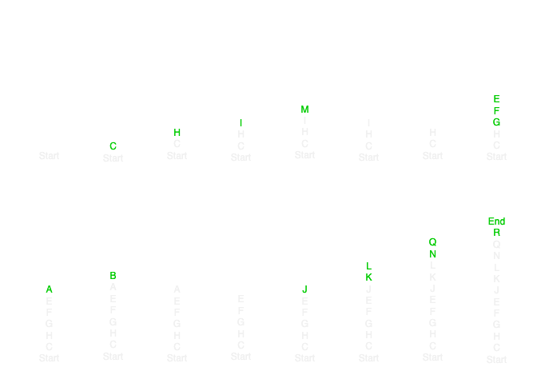
Use a stack and calculate the path for each direction
RIGHT → LEFT → BOTTOM → TOP

Slide 11
Final Path on which the bolls travels and reach the destination
Start | C | H | G | F | E | J | K | L | N | Q | R | End

Slide 12
Python Code:
def hasPath(maze, start, destination):
def dfs(x, y):
if visitedList[x][y]:
return False
visitedList[x][y] = True
if [x, y] == destination:
return True
for dx, dy in [(1, 0), (-1, 0), (0, 1), (0, -1)]:
next_x, next_y = x, y
while ((0 <= next_x + dx < len(maze))and (0 <= next_y + dy < len(maze[0]))and (maze[next_x + dx][next_y + dy] == 0)):
next_x += dx
next_y += dy
if dfs(next_x, next_y):
return True
return False
visitedList = [[False] * len(maze[0]) for _ in range(len(maze))]
return dfs(start[0], start[1])

Slide 13
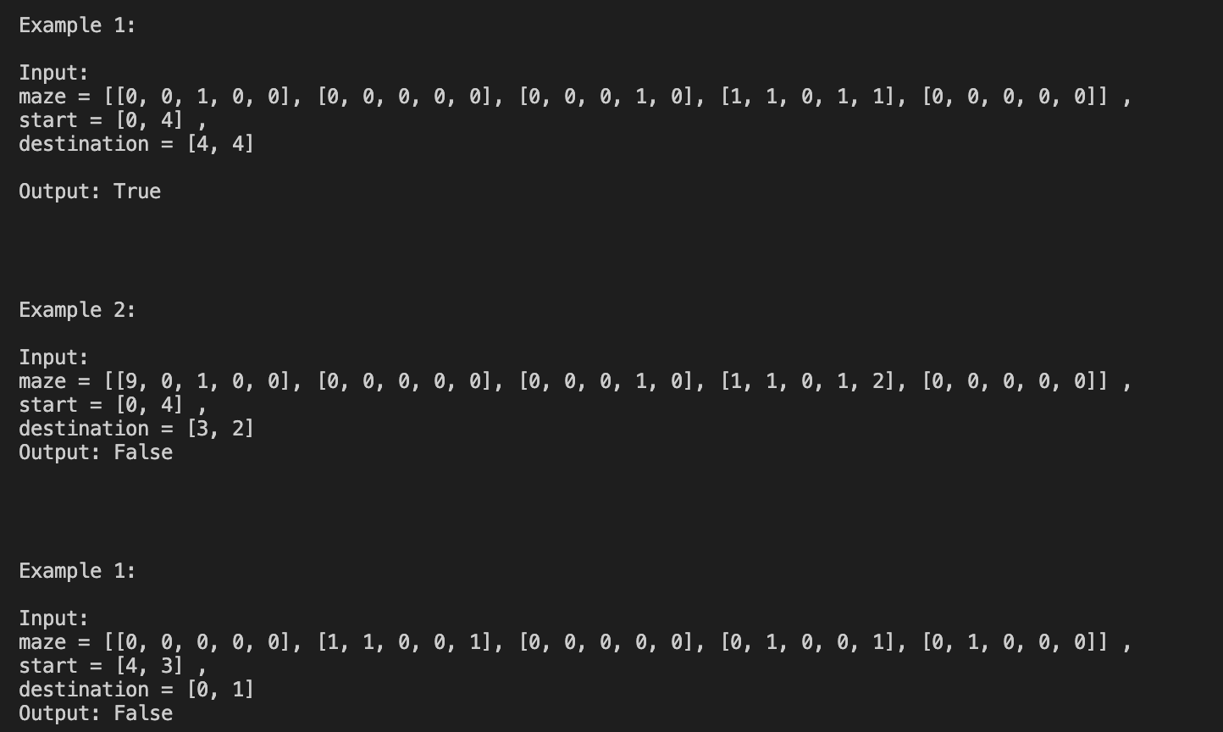
Acknowledgement

Slide 14
Github Project:
References:
https://github.com/AkshayPatel8140/Algorithm/tree/main/Breadth%20First%20Search
https://leetcode.com/problems/the-maze/description/
https://en.wikipedia.org/wiki/Maze_generation_algorithm#:~:text=Randomized%20depth%2Dfirst%20search,-Animation%20of%20generator&text=This%20algorithm%2C%20also%20known%20as,a%20maze%20using%20a%20computer.
https://en.wikipedia.org/wiki/Maze-solving_algorithm

Slide 15
Thank You

